Slide 1
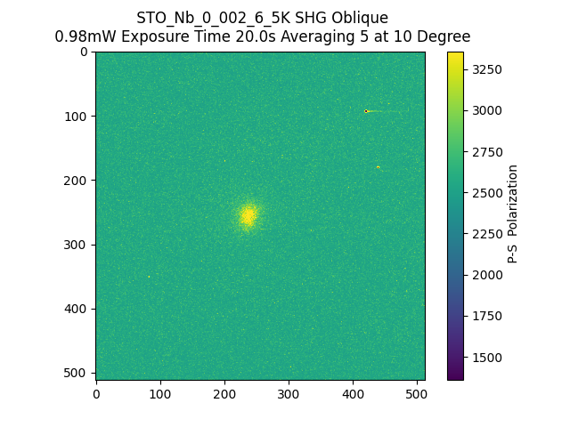
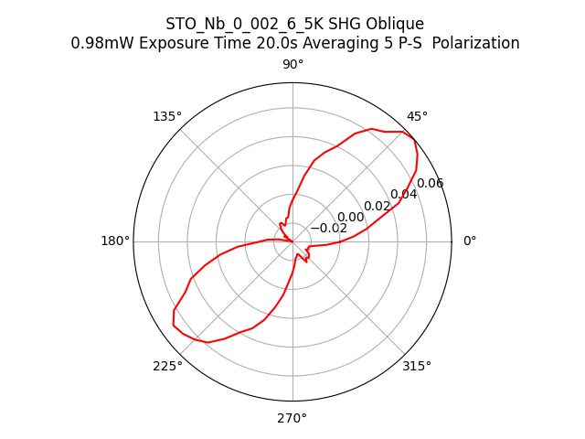
084506_STO_Nb_0_002_6_5K_SHG_Oblique_PS

